Slide 1



Nest structure influences colony relocation in harvester ants
Artem Pashchinskiy, Noa Pinter-Wollman - Pinter-Wollman’s Lab

Slide 2

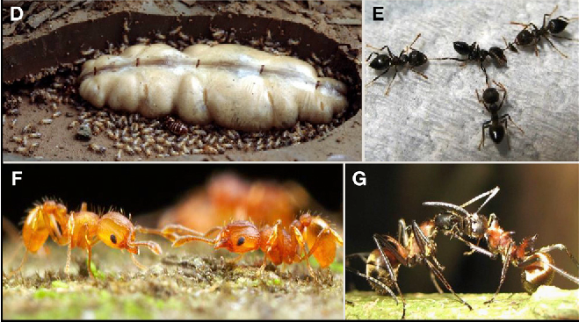
Collective behavior of social insects
Social insects are the main focus of the studies in our laboratory
Bees, Ants, Social Spiders
https://doi.org/10.1016/j.cell.2016.01.035
Collective behavior
Tasks performed by the group
No unified control center
Self-organization
Examples of collective behavior
Foraging
Nest maintenance
Nest relocation

Slide 3
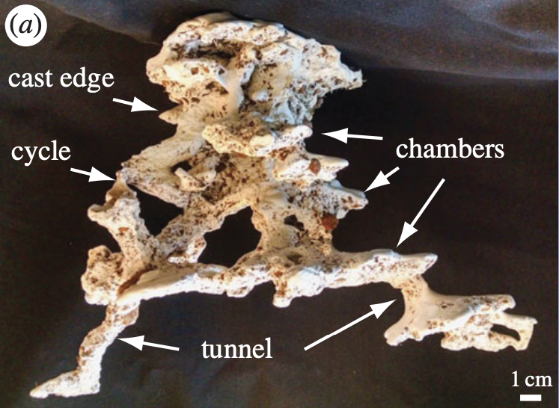
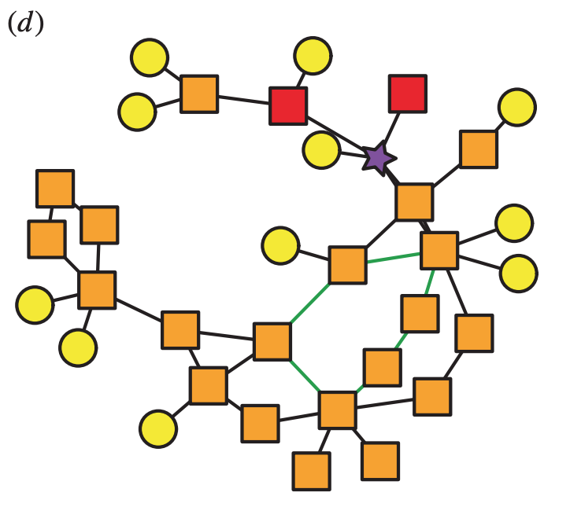
Ant nest architecture
A typical harvester ant nest consists of several spread out “rooms” ‑ chambers connected with narrow “passages” - tunnels
A cast of an ant nest
Network representation of a nest (each node is a chamber)
https://doi.org/10.1098/rsbl.2015.0695

Slide 4
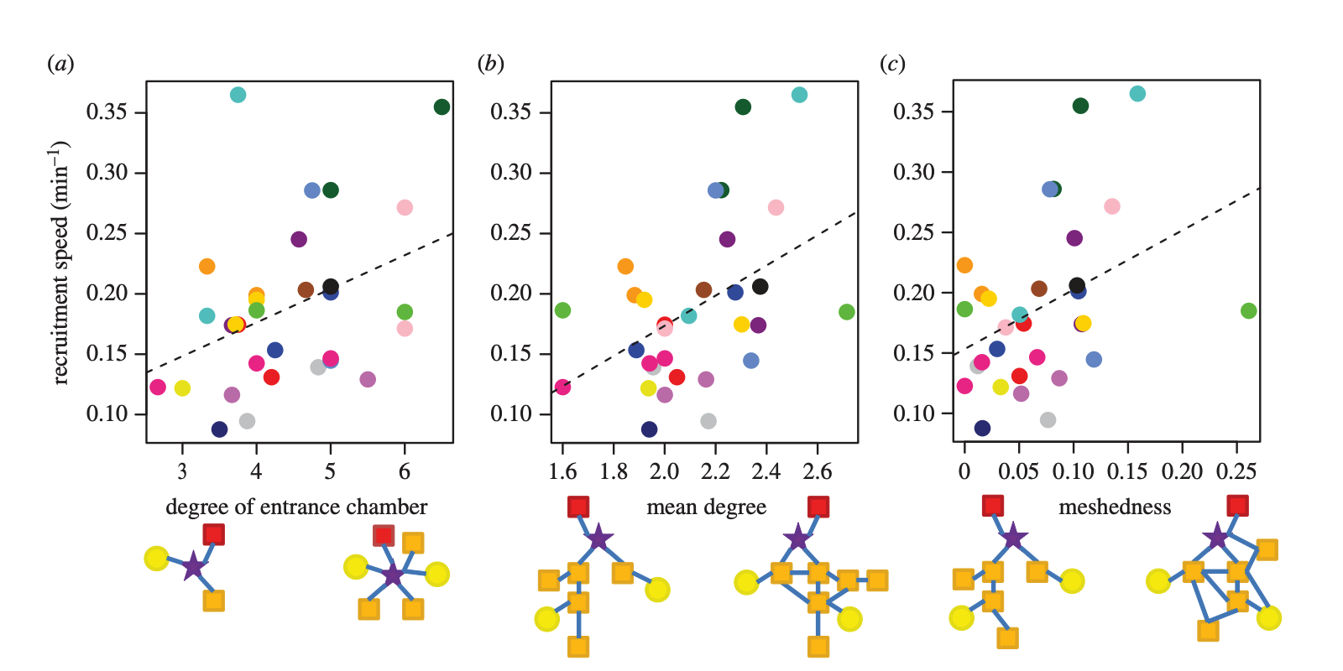
Nest architecture shapes the collective behavior of harvester ants
Colony’s speed of recruitment to food increases in nests with better chamber connectivity and higher redundancy of tunnel connections
Recruitment Speed
Degree of entrance
Mean degree
Meshedness
https://doi.org/10.1098/rsbl.2015.0695

Slide 5
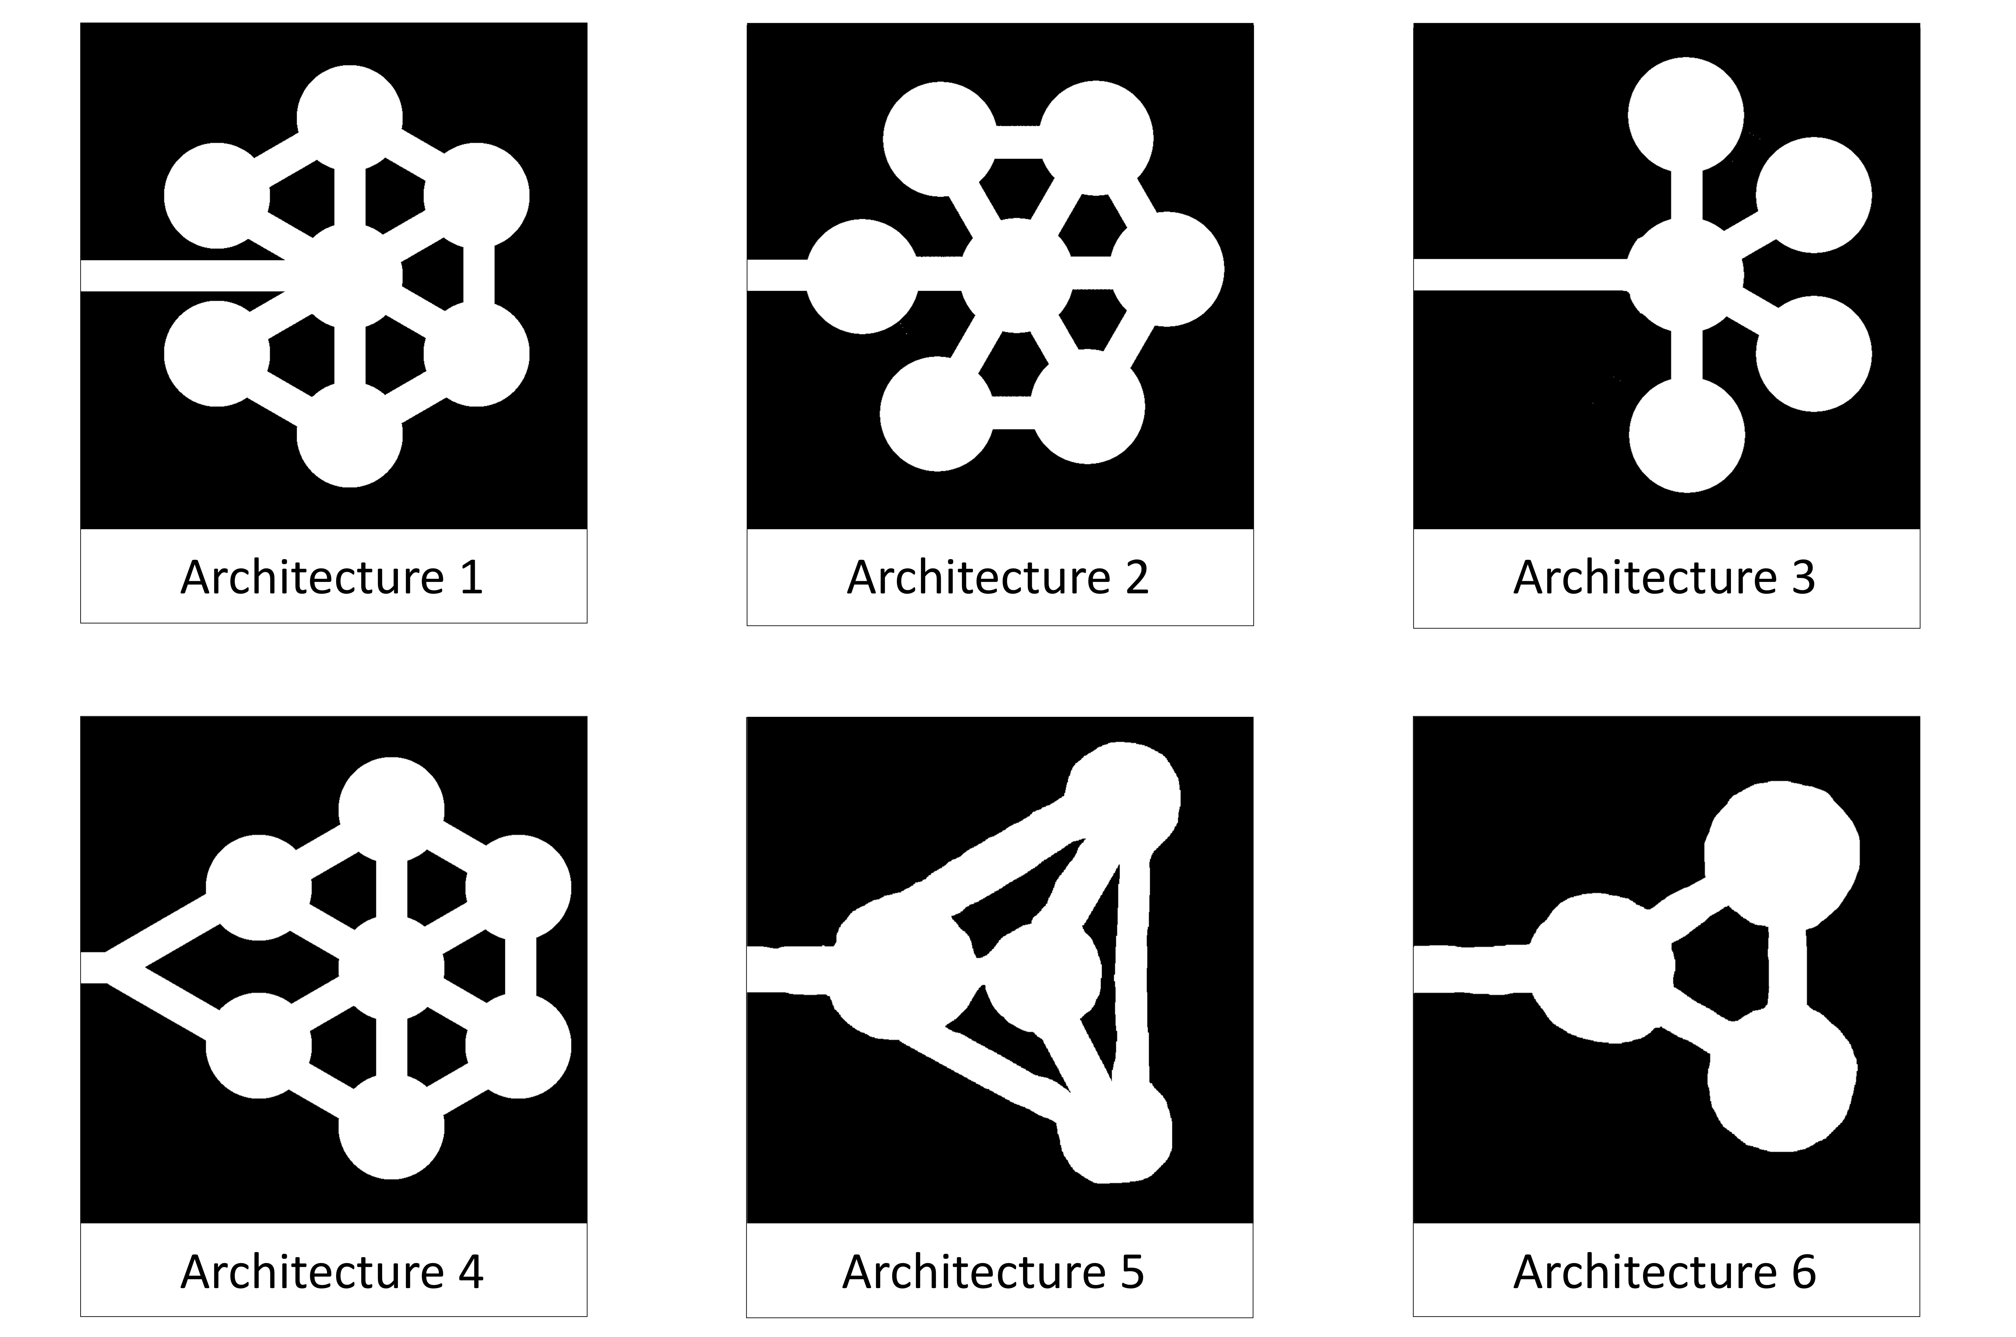
Architectures of interest
Artificial architectures

Slide 6
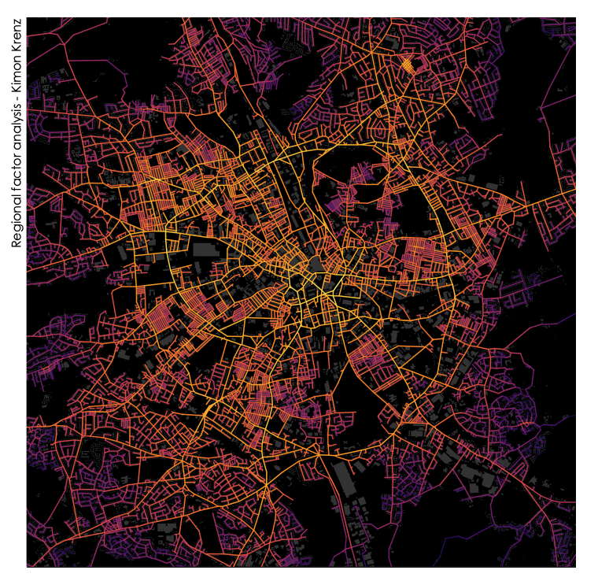
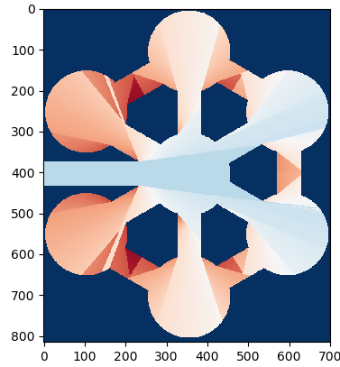
Space syntax
Space syntax is an area of study that investigates the relationship between societies and space
Accessibility of certain areas in an ant nest can be quantified with space syntax techniques
An example of a space syntax study performed at a city-wide level

Slide 7
Space Syntax
Collective behavior of social insects
Nest architecture shapes collective behavior
How?
Which features of the architecture are relevant?
Already known
My project

Slide 8
Project objectives - A
Verify that nest architecture affects collective behavior beyond foraging recruitment by showing similar tendencies in nest relocation

Slide 9
Project objectives - B
Build a reliable computer simulation replicating the relevant features of the relocation event

Slide 10
Project objectives - C
Identify the mechanism of architecture’s influence on relocation efficiency
- this is the main why it happens question -

Slide 11
Verify that nest architecture affects collective behavior beyond foraging recruitment by showing similar tendencies in nest relocation
Build a reliable computer simulation replicating the relevant features of the nest relocation event
Identify the mechanism of architecture’s influence on relocation efficiency

Slide 12
Project objectives
Verify that nest architecture affects collective behavior beyond foraging recruitment by showing similar tendencies in nest relocation
Build a reliable computer simulation replicating the relevant features of the nest relocation event
Identify the mechanism of architecture’s influence on relocation efficiency

Slide 13
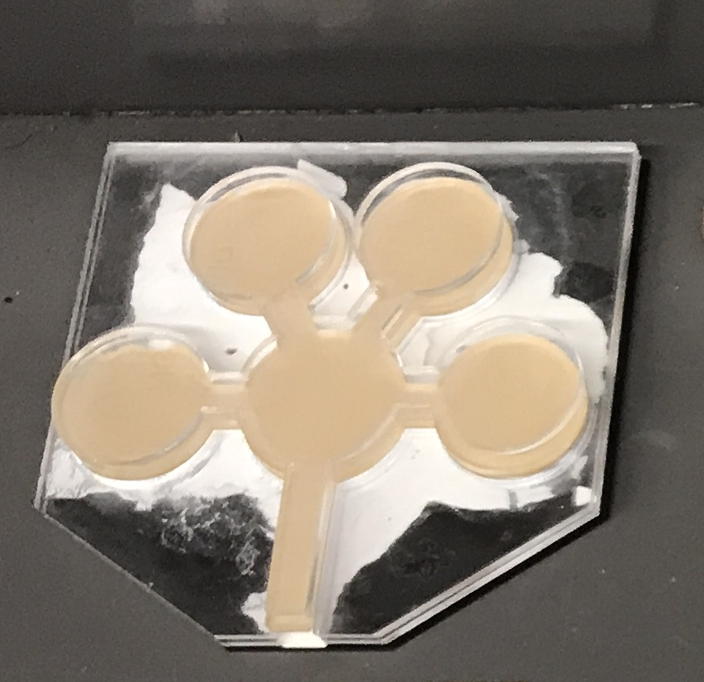


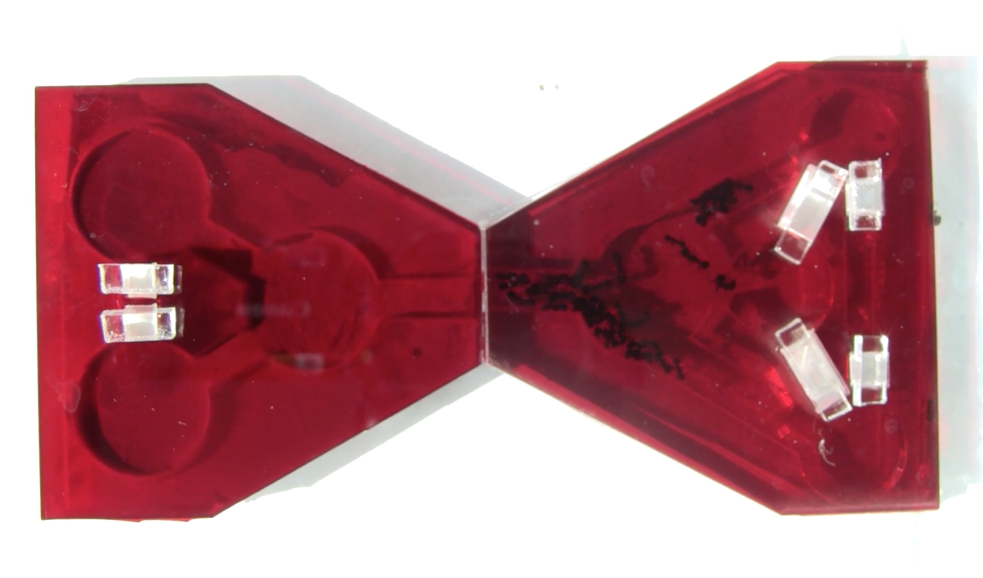
Empirical experiments
Laser cut artificial nests
Ants occupy the one nest for couple days
Another nest is provided
Heat is applied to the first nest to induce relocation
Filmed for 20 minutes and number of relocated ants is counted
Relocation

Slide 14
Empirical experiments
Laser cut artificial nests
Ants occupy the one nest for couple days
Another nest is provided
Heat is applied to the first nest to induce relocation
Filmed for 20 minutes and number of relocated ants is counted
Relocation

Slide 15
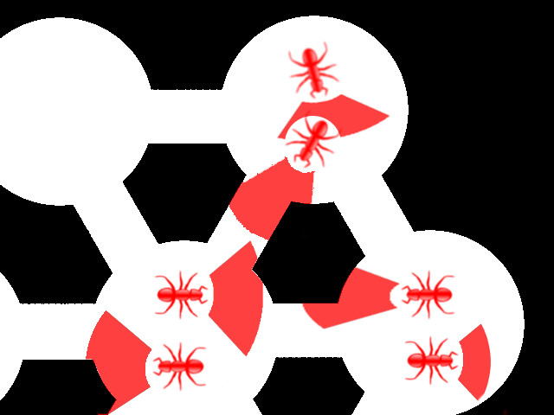
Computational model
Stochastic agent-based model
Each agent makes individual decisions
Maximal length of step is affected by the direction to nest exit (modeling the temperature effect)
Tortuosity (turning range) is individual to each agent
Relocation
Shaded red regions represent area available for each agent at the next time step

Slide 16
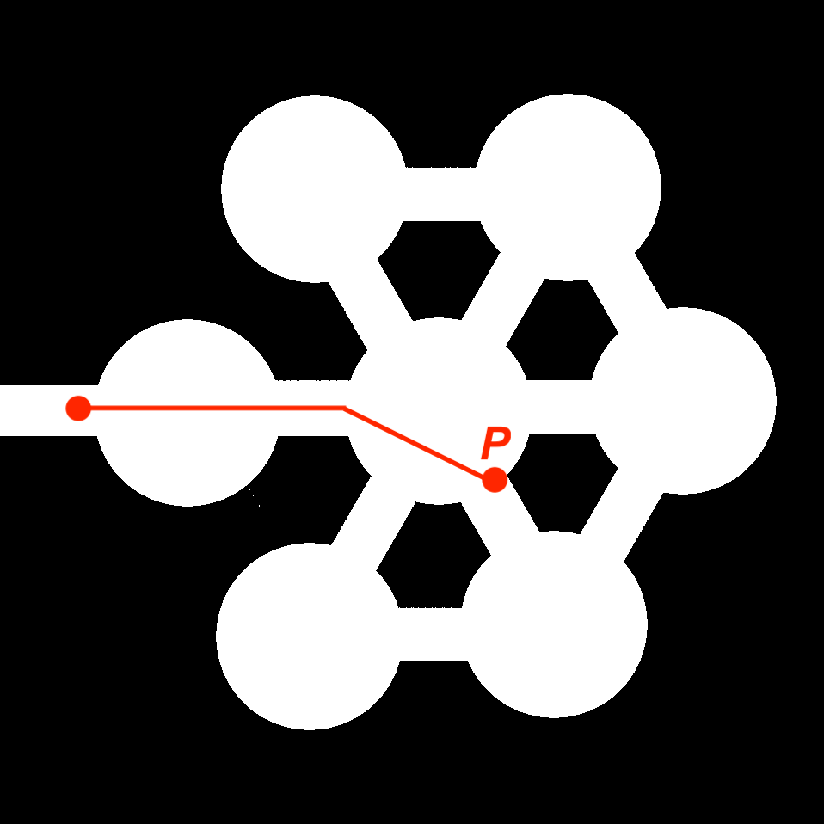
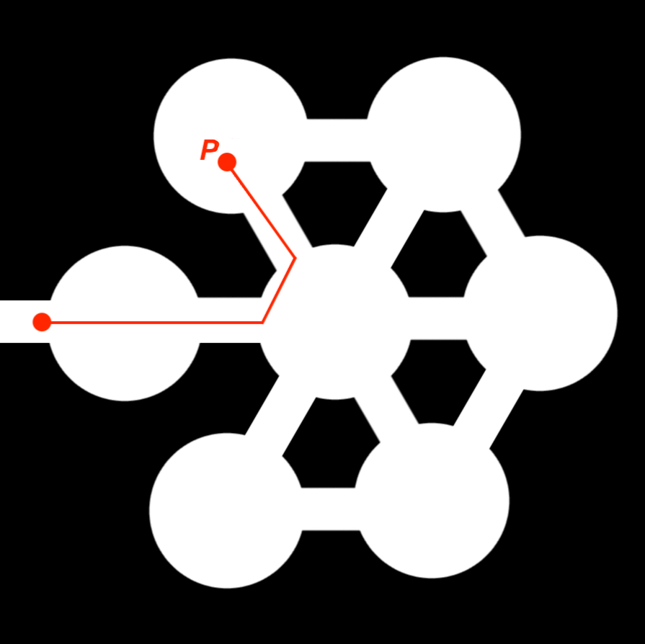
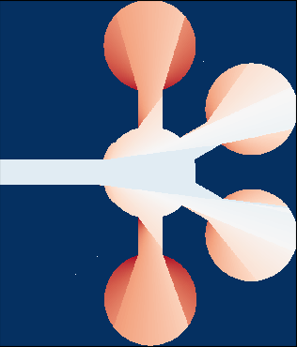
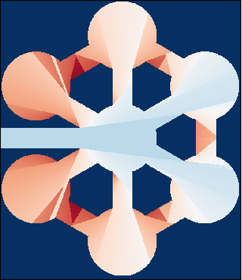
Space quantification
Inspired by Space Syntax techniques, we developed two indices measuring how direct a path to the nest exit is
PCI is a local metric measuring the curviness of the exit path from a single point
ACI is a summary metric measuring the average curviness of the exit path in a given nest architecture
PCI = 0.06
PCI = 0.59
ACI = 3.08
ACI = 1.97
LESS CURVY
MORE CURVY
LESS CURVY
MORE CURVY

Slide 17
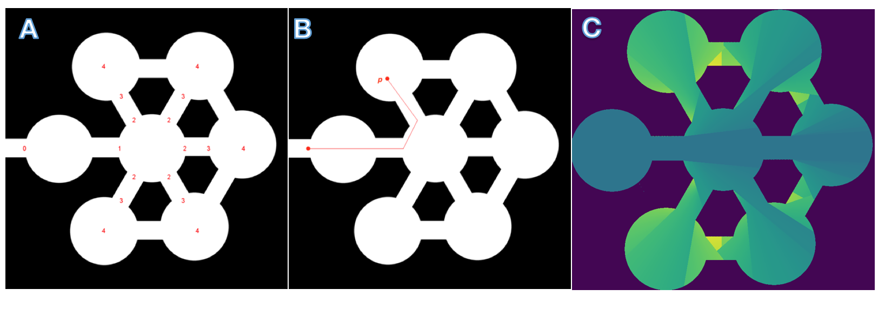
Point Curvature Index (PCI)
Point Curvature Index (PCI)
PCI is a local metric measuring the curviness of the exit path from a single point
A – Key points manually placed in the nest to facilitate optimal path search
B – An example of an optimal path from point p to the nest exit
C – Heatmap of obtained point CI values (blue – low curvature, yellow – high)

Slide 18
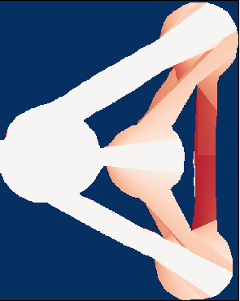
Aggregated Curvature Index (ACI)
Aggregated Curvature Index (ACI)
ACI is a summary metric measuring the average curviness of the exit path in a given nest architecture
ACI = 7.45
ACI = 1.97
ACI = 3.08
LESS CURVY
MORE CURVY

Slide 19
How it comes together
Data
Run some experiments
Model
Develop a model and parametrize it based on the empirical data
Predict
Run simulated experiments in a variety of architectures to make predictions about mechanisms of influence
Test
Run more real life experiments targeted at checking the predictions of the model
Analyze
Put together data from simulations and empirical experiments and run statistical analysis on it
Curvature Index hypothesis appeared here

Slide 20

Agent level
Collective level
Starting position PCI affects relocation probability
Less ants relocate from nests with highly curvy architecture

Slide 21
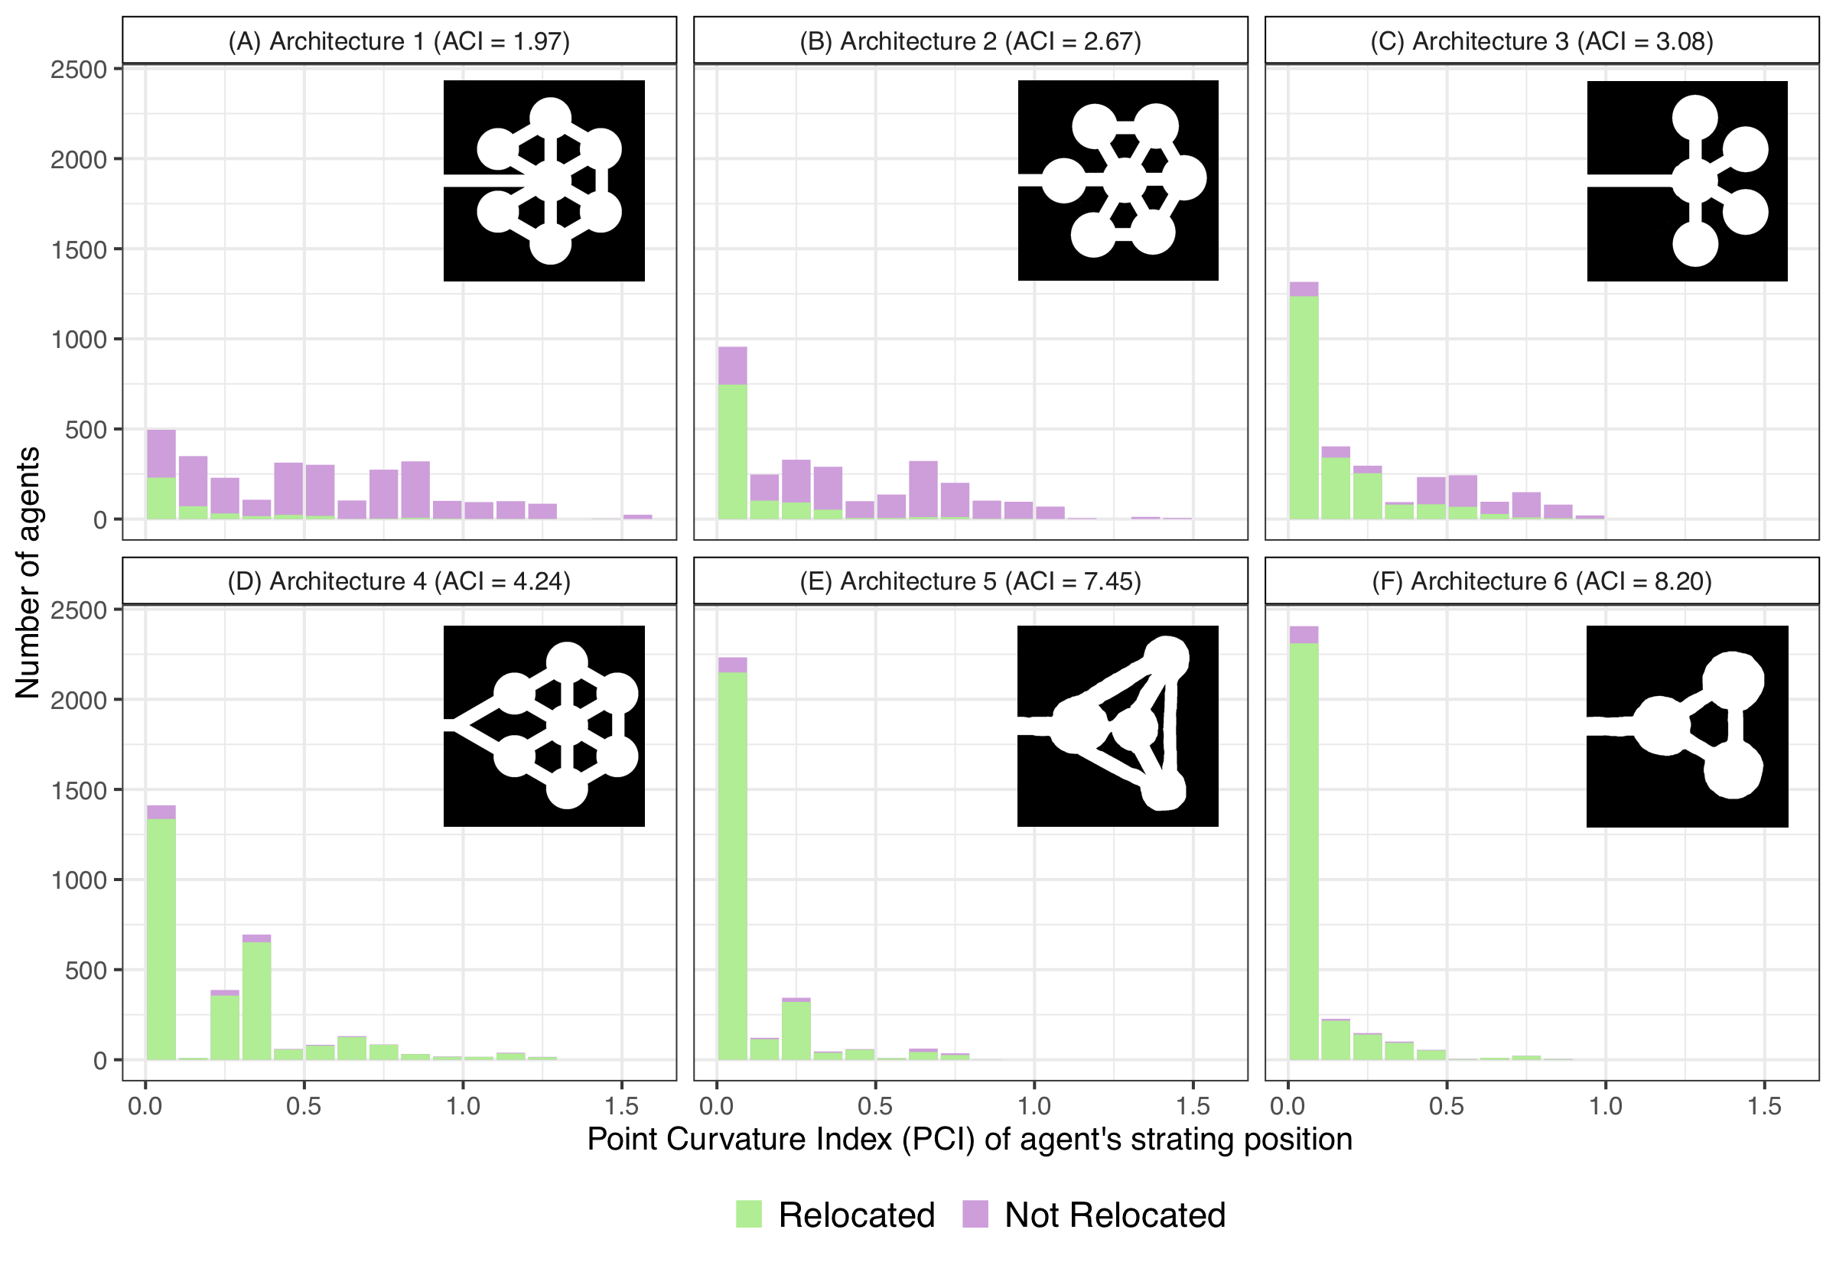
Agent Level Results

Slide 22
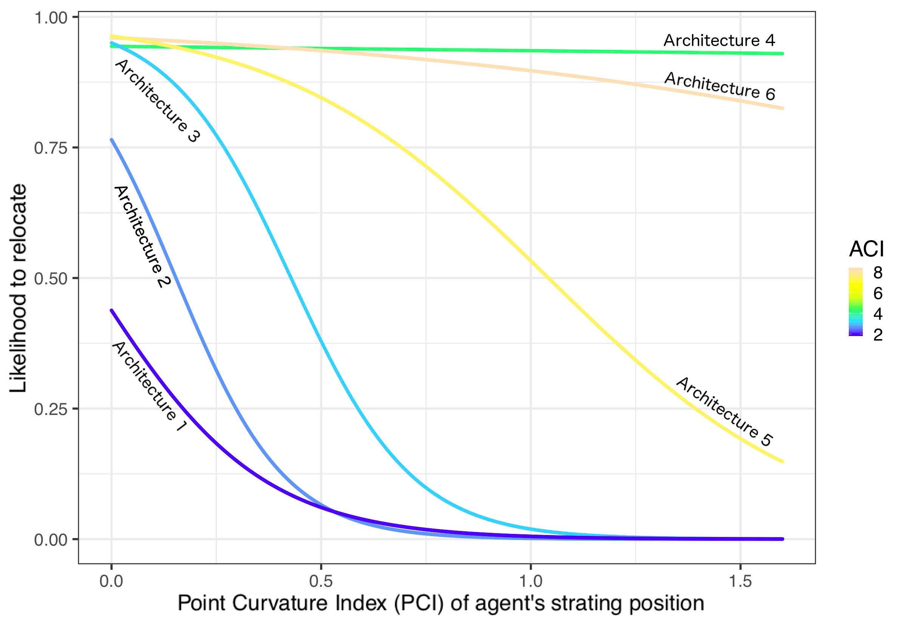
Agent Level Results

Slide 23
Architecture Level Results

Slide 24
Conclusions
Both PCI and ACI are predictive of the colony relocation success
Overall curviness of the architecture has an effect on relocation that acts in parallel to the influence of the starting position conditions
Curviness matters the most in the more curvy architectures (ACI < 4) and matters less in the simpler ones (ACI > 4)
Computational model correctly predicts the shape of the trend in relocation proportion change, but overestimates relocation efficiency for simple (ACI > 4) architectures

Slide 25
Practical implications and further work
A combination of PCI and ACI measures can be further developed into a novel way of quantifying the complexity of living spaces
Our computational model can be used to develop and test new hypotheses about the dynamics of nest relocation in V. Andrei
Other space quantification measures should be tested for correlation with the effectiveness of collective behavior

